Slide 1
CHAPTER 2
Basic Structures: Sets, Functions, Sequences, and Sums
2.1 Sets
2.2 Set Operations
2.3 Functions
2.4 Sequence and Summations
2.5 Cardinality of Sets
[The slides are courtesy of Prof. Lanfen Lin]

Slide 2
2.1 Sets
1. Background
Set theory is the branch of mathematics that studies sets.
Set is the fundamental discrete structure upon which all other discrete structures are built.
G. Cantor (1845-1918)
  German mathematician
  The founder of set theory (Naive set theory)
  Great achievement: research on infinite sets.

Slide 3
2.1 Sets
Some Concepts of Sets
【Definition】A set is an unordered collection of objects.
【Definition】The objects in a set are called the elements, or
members, of the set.
A set is said to contain its elements.
Note:
Uppercase letters are usually used to denote sets, and lowercase letters are usually used to denote elements of sets.
a ∈ A: a is a member (an element) of the set A
  a ∉ A: a is not an element of the set A

Slide 4
Russell Paradox
  Suppose there is a town with just one male barber; and that every man in the town keeps himself clean-shaven: some by shaving themselves, some by attending the barber. The barber obeys the following rule: he shaves all and only those men in town who do not shave themselves. Does the barber shave himself?

Slide 5
2.1 Sets
The descriptions of a set
  One can describe a set by
  Roster method: listing all its members between braces
  For example,
      The set of all odd positive integers less than 10 can be expressed by {1,3,5,7,9}
      (2) S = {a, b, c, d}
  Brace notation with ellipses
  For example,
  The set S of positive integers less than 100 can be
  denoted by S = {1, 2, 3, . . . , 99 }

Slide 6
2.1 Sets
  Specification using set builder
S= {x| P(x)}
---- S contains all the elements from U which have the
property P.
Universal set U:
----The set contains all the objects under consideration.
For example,
{x | x is an odd positive integer less than 10}

Slide 7
2.1 Sets
Venn diagrams
  In Venn diagrams, the universal set U is represented by a rectangle.
  Inside this rectangle, circles or other geometrical figures are used to represent sets.
  Points are used to represent the particular elements of the set.
U
A
B

Slide 8
2.1 Sets
Note:
  The Order of elements does not matter.
  {1, 2, 3} = {3, 2, 1}
  Repetition of elements does not matter.
  {1, 1, 2, 3, 3} = {1, 2, 3}
〖Example 1〗Several sets and their notations are used throughout this book.
  (1) R = {x | x is a real number}
  (2) N = { x | x is a natural number}
  (3) Z = { x | x is an integer}
  (4) Z⁺ = { x | x is a positive integer}
  (5) φ -- The void set / null set / empty set

Slide 9
2.1 Sets
The relations between two sets
① Subset
  A⊆B ---- A is a subset of the set B.
A⊆B ⇔ ∀x (x ∈A → x ∈B)
Problems:
  For any set A,
  (1) φ ⊆ A?
    Y.
    The empty set is a subset of any set.
  (2) A ⊆ A?
    Y.

Slide 10


2.1 Sets
② Equal
A = B ⇔ ∀x[(x ∈A→ x ∈B) ∧ (x ∈B→ x ∈A)]
〖Example 2〗S1 = {a, b, c, d}, S2= {a, d, b, c}, S3={b, c, a, d, d} .
S1 = S2 = S3?
③ Proper subset
A⊂B ⇔ ∀x (x∈A → x∈B) ∧ ∃x(x∈B∧x∉A)

Slide 11
2.1 Sets
【Definition 】 Let S be a set. If there are exactly n distinct elements in S where n is a nonnegative integer, we say that S is a finite set and that n is the cardinality of S.
Notation:
∣S∣---- the cardinality of S
【Definition 】A set is said to be infinite if it is not finite.
For example,
  The set of positive integers is infinite.
〖Example 3〗
  (1) Let A be the set of odd positive integers less than 10. Then︱A︱=?
  (2) ︱φ︱ = ?

Slide 12


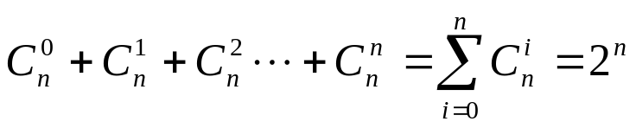
2.1 Sets
2. The power set
〖Example 4〗 Let , find all subsets of the set A.
Solution:
  φ
  {a},{b},{c}
  {a, b},{b, c},{a, c}
  {a, b, c}
Problem: How many subsets of the set A are there?
In general, for a set A with n elements, the number of subsets is

Slide 13




2.1 Sets
【Definition 】Given a set S, the power set of S is the set of all subsets of the set S.
Notation:
P(S) ---- the power set of S.
Note:
    (1) |S|=n implies |P(S)| = 2^{n}
    (2) S is finite and so is P(S).
    (3)

Slide 14




2.1 Sets
〖Example 5〗 What is the power set of the set ?
Solution:

Slide 15



2.1 Sets
〖Example 6〗 Show that ?
Proof:
Problem:

Slide 16



2.1 Sets
3. Cartesian Products
【Definition 】The ordered n-tuple (a₁,a₂,…,a_{n}) is the ordered collection that has a₁ as its first element, a₂ as its second element, … , and a_{n} as its nth element.
(a₁, a₂, …,a_{n}) =(b₁, b₂, …, b_{n}) ⇔ a_{i} = b_{i} (i=1,2,…, n)
In particular, 2-tuples are called ordered pairs.
Note:
If ，then .

Slide 17

2.1 Sets
The Cartesian product of A and B:
The Cartesian product of A₁, A₂, … , A_{n} :
A₁×A₂×…×A_{n} = {(a₁, a₂, …, a_{n})∣a_{i}∈A_{i} for i=1, 2, …., n}.

Slide 18





2.1 Sets
〖Example 7〗 ,
solution:
Note:
  If |A|=m, |B|=n, Then

Slide 19
2.1 Sets
5. Truth Sets of Quantifiers
Given a predicate P, and a domain D.
The truth set of P is the set of elements x in D for which P(x) is true. namely,
    The truth set of P = {x ∈D | P(x) }

Slide 20
Homework (Due on March 23)
Ver. 7
Sec. 2.1 11, 18, 22, 24, 32(a),(c)
Ver. 8
Sec. 2.1 13, 20, 24, 26, 34(a),(c)

Slide 21
CHAPTER 2
Basic Structures: Sets, Functions, Sequences, and Sums
2.1 Sets
2.2 Set Operations
2.3 Functions
2.4 Sequence and Summations
2.5 Cardinality of Sets

Slide 22
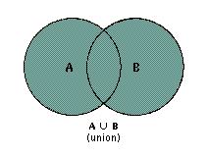

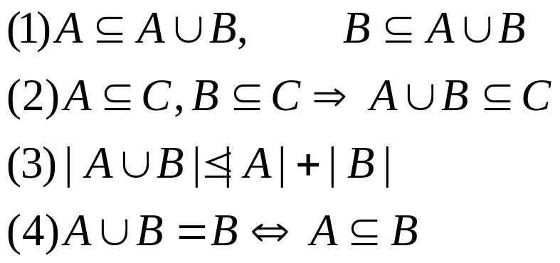
2.2 Set Operations
1. Set Operations
1) Union
According the Venn diagram,

Slide 23
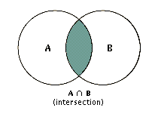

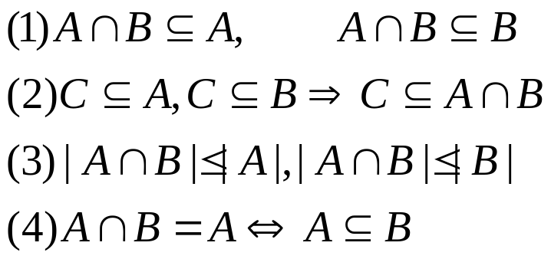
2.2 Set Operations
2) Intersection
According the Venn diagram,

Slide 24
2.2 Set Operations
2) Intersection
Two sets are called disjoint if their intersection is the empty set, namely A∩B = Ø

Slide 25

2.2 Set Operations
The cardinality of the union of two finite sets:

Slide 26

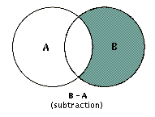
2.2 Set Operations
3) Difference of A and B
B
A
A – B

Slide 27



2.2 Set Operations
4) the complement of a set
A
Where U is the universal set
Note:
5) Symmetric difference

Slide 28



Four ways to prove set identities
Show that A ⊆ B and that A ⊇ B.
Use logical equivalences to prove equivalent set definitions.
Use a membership table.
Use previously proven identities.
Like truth tables

Slide 29








2.2 Set Operations
〖Example 1〗 Show that ?
solution:
(1) C = D iff C ⊆ D and D ⊆ C
Suppose that .
It follows that .
This implies that .
Hence, .
Thus .
(detail omitted)
Q.E.D.

Slide 30








2.2 Set Operations
〖Example 1〗 Show that ?
solution:
(2) Use set builder notation and logical equivalences

Slide 31

2.2 Set Operations
〖Example 2〗 Let A, B, and C be sets. Show that
Membership Table
A | B | C | B∪C | A∩(B∪C) | A ∩ B | A ∩ C | (A ∩ B) ∪(A ∩ C)
1 | 1 | 1 | 1 | 1 | 1 | 1 | 1
1 | 1 | 0 | 1 | 1 | 1 | 0 | 1
1 | 0 | 1 | 1 | 1 | 0 | 1 | 1
1 | 0 | 0 | 0 | 0 | 0 | 0 | 0
0 | 1 | 1 | 1 | 0 | 0 | 0 | 0
0 | 1 | 0 | 1 | 0 | 0 | 0 | 0
0 | 0 | 1 | 1 | 0 | 0 | 0 | 0
0 | 0 | 0 | 0 | 0 | 0 | 0 | 0

Slide 32

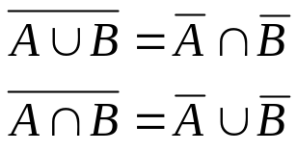
2.2 Set Operations
3. Set Identities
Set Identities
Identity | Name
A ∪ ∅ = A, A ∩ U = A | Identity laws
A ∪ U = U, A ∩ ∅ = ∅ | Domination laws
A ∪ A = A, A ∩ A = A | Idempotent laws
 | Complementation law
A ∪ B = B ∪ A, A ∩ B = B ∩ A | Commutative laws
A ∪(B ∪ C) = (A ∪ B) ∪ C A ∩(B ∩ C) = (A ∩ B) ∩ C | Associative laws
A ∩(B ∪ C) =(A ∩ B) ∪(A ∩ C) A ∪(B ∩ C) =(A ∪ B) ∩(A ∪ C) | Distributive laws
 | De Morgan’s laws

Slide 33





2.2 Set Operations
〖Example 3〗 Show that ?
solution:

Slide 34





2.2 Set Operations
〖Example 4〗 Simplify the following set.
solution:

Slide 35
A ∩ B = ∅
〖Example 5〗Proof that if (A - B) U (B - A) = (A U B) then ______
Proof:
A U B = ∅
A = B
A ∩ B = ∅
A-B = B-A = ∅
Suppose to the contrary, that A ∩ B ≠ ∅, and that x ∈ A ∩ B.
Then x cannot be in A-B and x cannot be in B-A.
Then x is not in (A - B) U (B - A).
But x is in A U B since (A ∩ B) ⊆ (A U B).
Thus, A ∩ B = ∅.

Slide 36
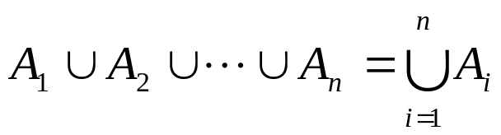
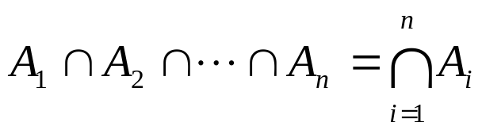
2.2 Set Operations
4. Generalized Unions and Intersections

Slide 37


2.2 Set Operations
5. Computer Representation of Set
Using bit strings to represent sets.
Specify an arbitrary ordering of the elements of U,
for instance
(2) Represent a subset A of U with the bit string of length n, where the ith bit is 1 if belongs to A and is 0 if does not belong to A.
Union: bitwise OR
Intersection: bitwise AND

Slide 38

2.2 Set Operations
〖Example 5〗 Let U ={1, 2, 3, 4, 5,6,7,8,9}, A={1, 2, 3, 4, 5}, B= (1, 3, 5, 7, 9). Use bit strings to find the difference of A and B.
solution:
The bit string for the set A: 11 1110 000
The bit string for the set B: 10 1010 101

Slide 39
Homework (Due on March 23)
Ver. 7
Sec. 2.2 17, 48, 57(c)
Ver. 8
Sec. 2.2 19, 54, 63(c)

